Slide 1
International Student House Accommodation
To find a cheaper and quality place to live in the UK

Slide 2
Market Research – Long term rent
Accommodation cost for a master student studying in the UK.
A double bed ensuit in student accommodation for 51 weeks is
£135*51=£6885
A double bed ensuit in house for 51 weeks is
£95*51=£4845
You can save £2040 per year (equals to a 6 week pre-session English course).

Slide 3
Questionnaire ：Do you prefer living at Student Accommodation or Houses in your first year? Why?
9 Master Students | Gender | Where did you live in your first year | Reason | Would you like to live in Private House | Reason | Reason for not choose house as your first choice
东哥 | Male | Student Accommodation | Internet Agent | Yes | Same as student accommodation Cheaper price | Don’t have information about house Don’t trust private landlords Potential Disputes
适 | Male | Private House | Friend Recommendation | Yes | Same as student accommodation Cheaper price | x
Rolando （Mexico） | Male | Student Accommodation | Internet Agent | Yes | Same as student accommodation Cheaper price | Don’t have information about house Don’t trust private landlords Payment security
Jules （Congo） | Male | Student Accommodation | Internet Agent | Yes | Same as student accommodation Cheaper price | Don’t have information about house Don’t know who is going to live with
张记 | Male | Private House | Friend Recommendation | Yes | Cheaper price | x
Project Man A （Nigeria） | Male | Student Accommodation | Internet Agent | Yes | More relax Cheaper price | Don’t have information about house Payment security
临 | Female | Student Accommodation | Internet Agent | No | Don’t need to share bathroom | x
茹 | Female | Student Accommodation | Internet Agent | No | Have security guard Safer | x
玉菡 | Female | Student Accommodation | Internet Agent | Yes | Cheaper | Don’t have information about house Don’t know who is going to live with

Slide 4
Market Research - Long term rent
Questionnaire Summary
7 out of 9 students would like to live in private house.
Among 7 people who would like to live in private house, only 2 people chose private house.
The major reasons are they don’t have access to UK house renting information, they have safe and security concern about living at private house and there is no platform to secure the payment transaction.

Slide 5
Market Research – Summer Short term rent
Pre-sessional English | Course dates | Fee
10 weeks | 04/07/16 - 09/09/16 | £2,900
6 weeks | 01/08/16 - 09/09/16 | £1,740
Main Student Accommodation | No. of room available | Price per week
University Accommodation | No Reponses only voice mail services | -
United Student Accommodation | Only available till 2nd September | -
Liberty Park | About 200 rooms | £125 (single bed ensuit)
Hope Street Apartment | 3 rooms | £121.50
X1 | No | -
The market research is done on 19/07/2016

Slide 6
Market Research – Summer Short term rent
Summary
There is only one student accommodation available for summer short term rent. Price is fixed £125 per week. Only single bed ensuit available.
The average short term in House is £80 per week. There are many choices. Students can choose 2 rooms apartments or even homestay with English people.
Savings
For 6 weeks English session: (125-80)*6=£270
For 10 weeks English session: (125-80)*10=£450 (equals to a single flight ticket)

Slide 7
Market Research – Summer Short term rent
 | Pros | Cons
Student Accommodation | Safe Easy to make payment | Expensive Limited choices Isolation (most of students living there are international students. It is not a good environment to learn English culture nor practice English)
House | Cheaper Most choices Free one to one English practices with English landlords or housemates. To be easier adapt to the local culture with the help of local residents. | The perception of unsafe living in houses Individual landlords are lack of reputation of their services No platform to secure payment transfer.

Slide 8
Market Research – September Short term
Master students have to find one month short-term lets to finish their study from 1 September to 30 September.
No student accommodation can offer short term during this time. There is almost no landlord will offer one-month rent.
Living in hotels for a month will cost about £1500.
There is no business providing affordable monthly rental price for international students.

Slide 9
Market Research - Tourism
 | 2011 | 2012 | 2013 | 2014 | 2015
Number of Chinese visit UK less than 6 months | 148,506,000 | 178,660,000 | 200,340,000 | 185,062,000 | 269,631,000
Adapted from VisitBritian https://www.visitbritain.org/markets/china
The number of Chinese visitors coming to UK increased 37% from 2014 to 2015.
The number of Chinese visitors coming to UK increased 81.56% from 2011 to 2015.
From January 2016, all Chinese visitor visa extends fro 6 months to 2 years. UK government is going to encourage Chinese visitors to travel to UK more than one time. This is likely to double the number of existing number of Chinese visitors coming to UK.
Longer visiting visa allowance means Chinese can have more time to study short term course in the UK. They can study short term course anytime during the year.
There is no business providing flexible renting for more than a month.

Slide 10
Competitors research
Long term rent
Chinese agent can not provide reliable house renting services. They are not based in the UK. They can’t provide instant service if students have disputes or problems with landlords.
UK agents which are most likely local based. They are less likely to operate a website just for Chinese students.

Slide 11
Competitors research
Summer Short term rent
There is only one student accommodation provide summer short term rent. The price is fixed at £125 per week.
Private house offer much lower price. It also provides more opportunity for international student to learn local language and culture.
September Short term rent
No company provide this service.

Slide 12
Marketing plan
Product
Long term rent
Properties will be found from Liverpool Student Home. They are qualitfied and are suitable for students.
Landlords will be able to provide maintance in time.
Summer Short term rent
There will be different types of housing. Student can do homestay or live with englishing people or live with their friends.
They will have cheaper but reliable source of accommodation
September Short term rent
Have long term relationship with providers who can provide shout term rent during this year every year.

Slide 13
Marketing plan
Price
Long term let
All price should be lower than student accommodation. Price is decided by individual landlords. About £95 per week.
Summer short term let
All price should be lower than student accommodation. Price is decided by individual landlords. About £80 per week
September short term let
Price will be higher than normal student accommodation/house but will lower than hotel
£120 per week for house
£200 per week for apartment

Slide 14
Marketing plan
Promotion
The website will be advertised on Chinese student forum, wechat.

Slide 15
Marketing plan
People
On the website , there will be people to receive calls or online chat.
Place
website

Slide 16
Finance plan
Start up cost
Business registration fee £15
Website development £2500
Business insurance £103
Advertising £0
Legal service fee £190 – 500/hr

Slide 17
Projected sales for 2017
 | No. of tenants | No. of landlords | Price | Turnover
Summer short term let | 20 | 4 | 50 | 20*50+4*50=£1200
September short term let | 30 | - | 50 | 30*50=£1500
Long term let | 30 | 6 | 200 , 100 | 30*200+6*100=£6600
Visitors studying short term course | 10 | 2 | 200 , 100 | 10*200+2*100=£2200
Total | 90 | 12 | - | £11,500
*Scale of students – Chinese students studying at Liverpool Universities.

Slide 18
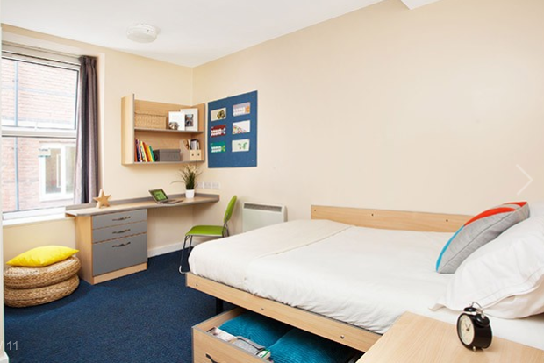




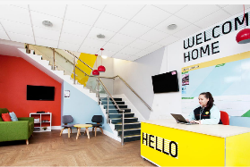

Find housemates/flatmates
Find a property that they both like
4.5
Education background, subject, years of renting
Safety
Distance
Maintenance
Service
Customer review
It is a great place to live!

Slide 19
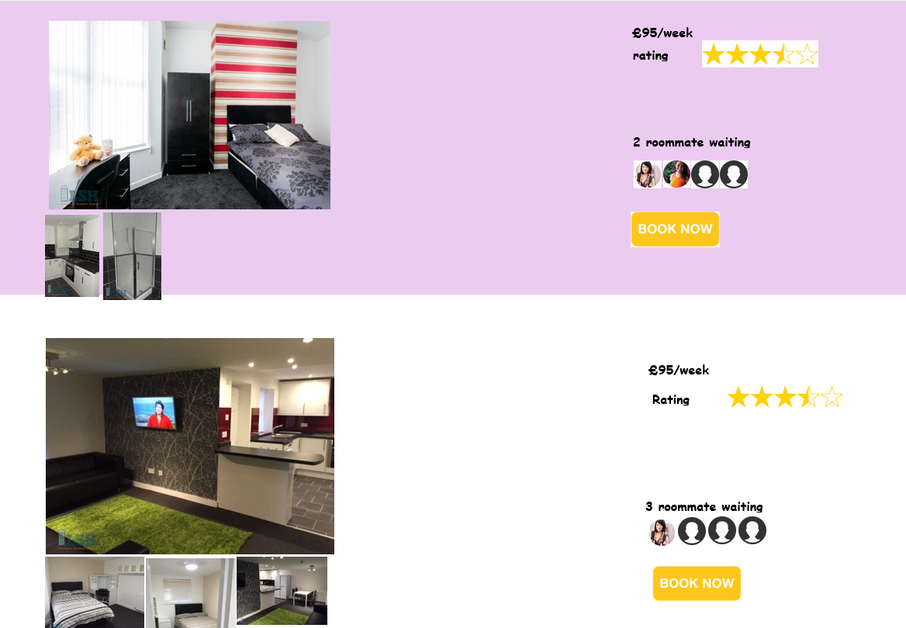
Find housemates/flatmates
If they find housemates/flatmates and they would like to live at the same place. They can book together.
If they can’t find suitable housemates/flatmates…

Slide 20
Notes
Short-term study visa
6 months - for any short course (including English language courses), or short period of research if you’re 18 or over
11 months - if you’re 18 or over and taking an English language course
£89 for a 6 month visa
£170 for an 11 month visa
A Standard Visitor visa costs £87.
The fee for a long-term visit visa depends on its length:
2 years - £330
5 years - £600
10 years - £752
From 2016, new visitor visas for tourists from China will be valid in the UK for 2 years （https://www.gov.uk/government/news/pm-announces-significant-changes-to-visitor-visas-for-chinese-tourists-for-the-benefit-of-the-british-economy）
From 1 Oct 2013, visitor visa holder can study up to 30 days course. Courses can be sailing, kayaking training, the British court costumes tailor training, sports motorcycle driver’s license training, photography and other lifestyle courses. This suits Chinese professionals who wants to learn more advanced skills which might not exist in China.

